Slide 1
Informal letters

Slide 2
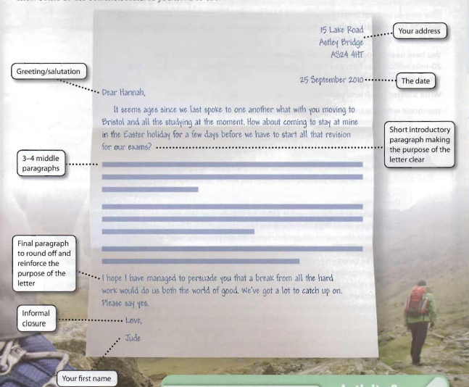
Notes:
Print out to stick in books as a model.

Slide 3
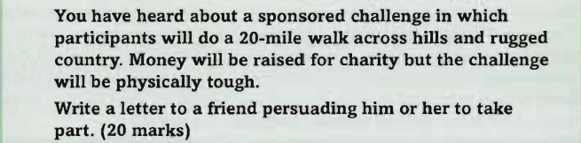
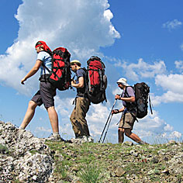
A typical question might look like this…
Make a plan for every paragraph.

Slide 4
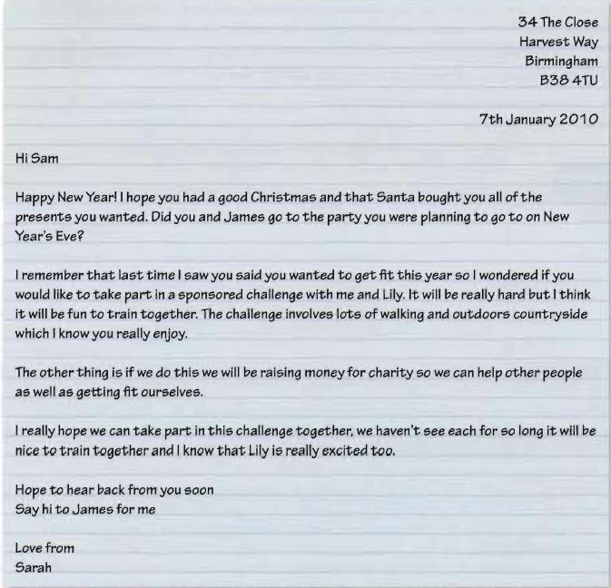
Here’s what a grade B could look like…
T

Slide 5
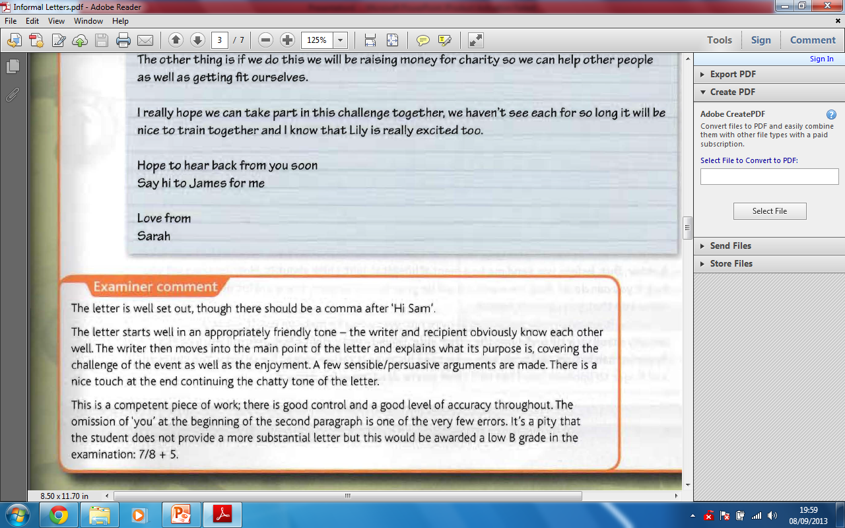
And here’s what the examiner said about it…

Slide 6
The question…
You’ve planned your points, you now have 20 minutes to write an informal letter persuading your friend to take part in the challenge.
Key points:
Marked for content and organisation – does it flow, are your language choices and vocabulary appropriate?
Marked for sentence structure, spelling and punctuation – get these basics right. Marking on these elements this year, was tougher than it’s ever been before…

Slide 7
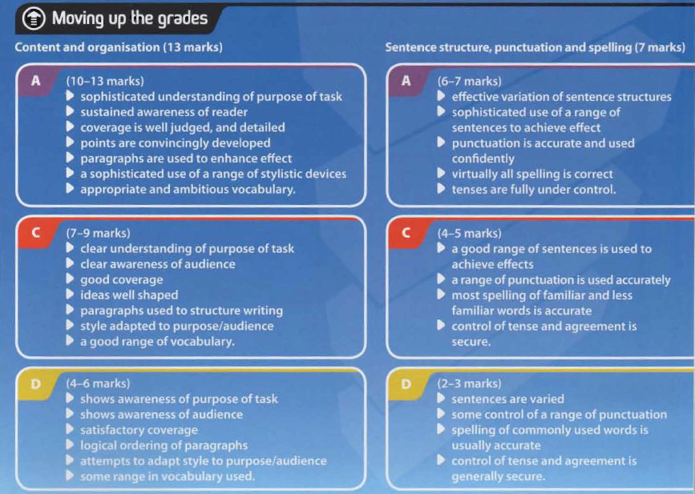

Slide 8
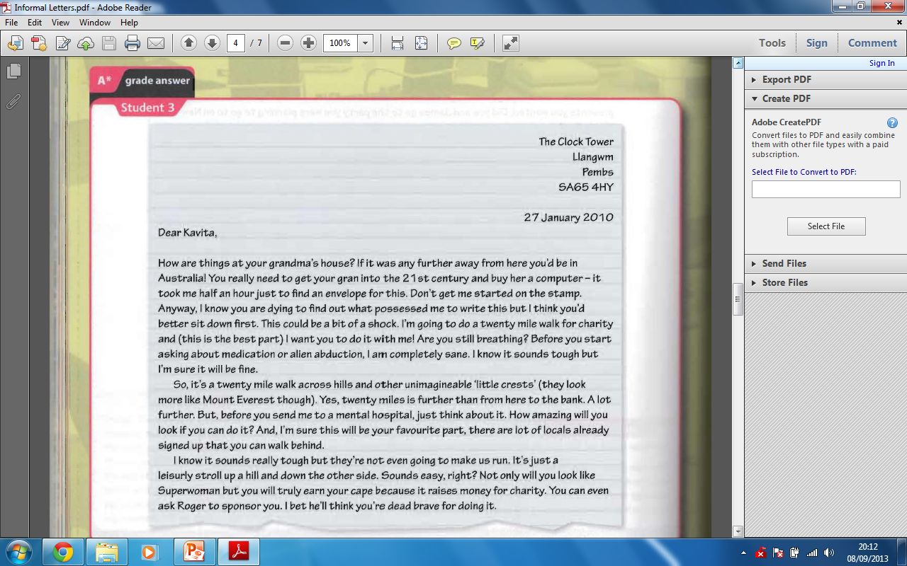
A* model answer…

Slide 9
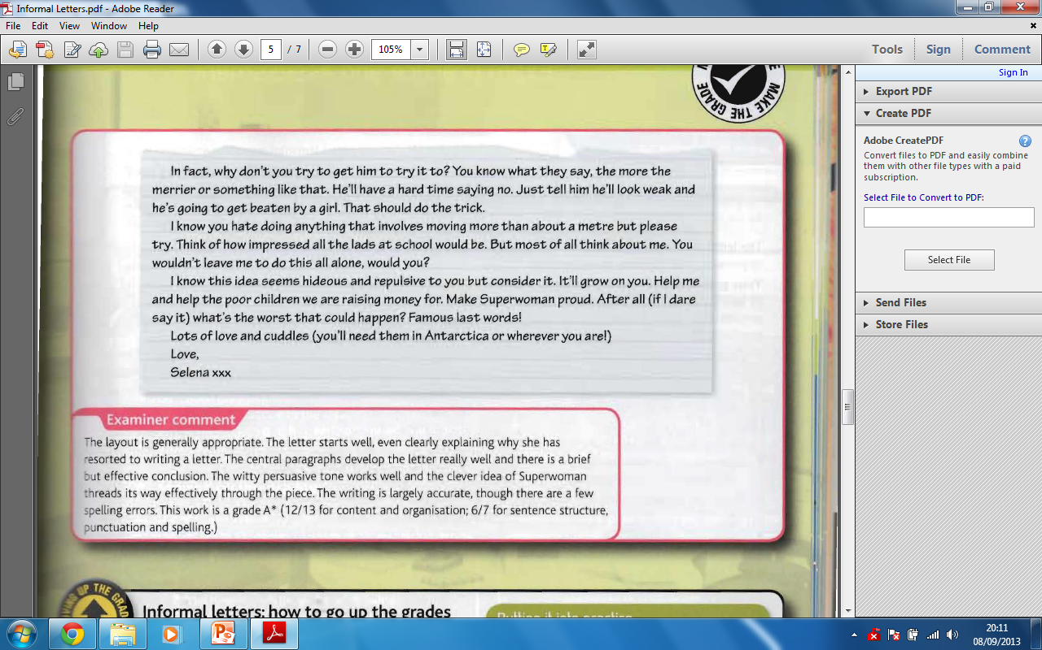

Slide 10
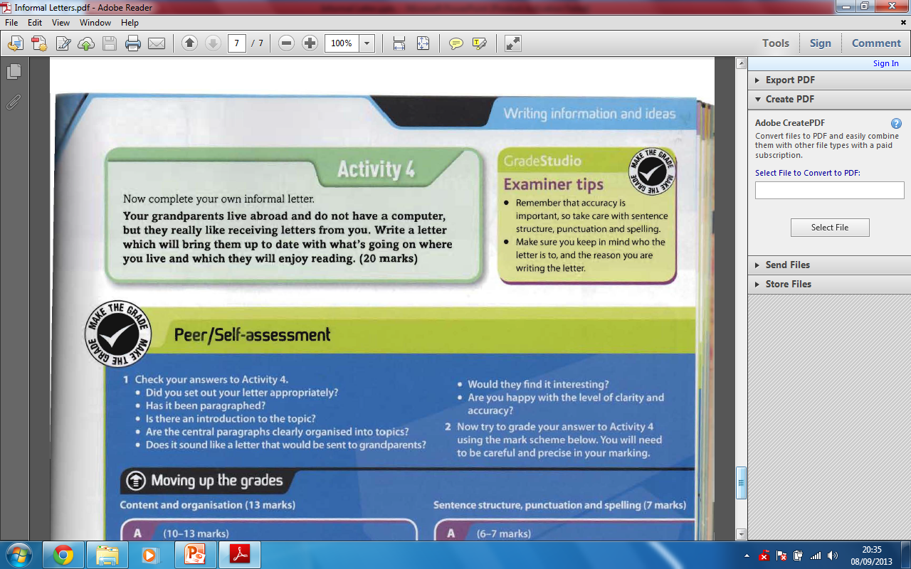
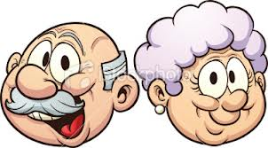
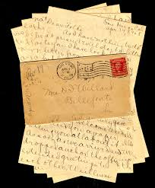

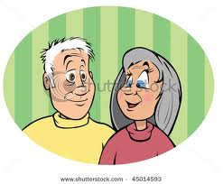
Homework… ☺

