Slide 1


There are 10 main types of exam writing tasks:
Formal or Semi-Formal Letters
Informal Letters
Descriptions
Narratives
Reports
Reviews
Online comments
Articles
Leaflets
Essays

Slide 2
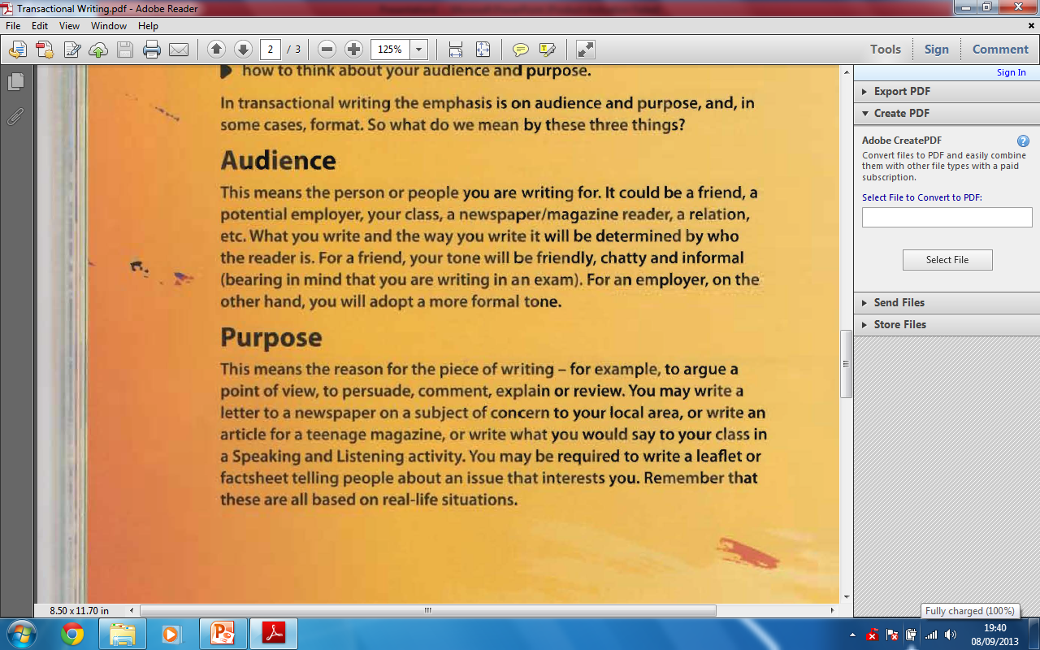

Slide 3
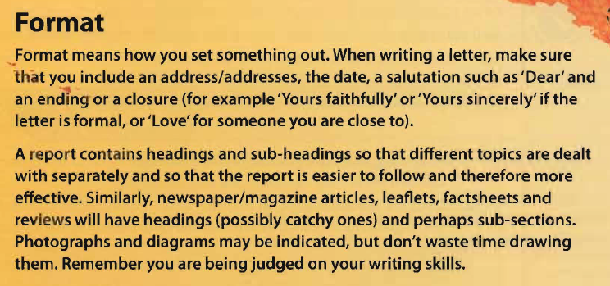
For every piece of writing,
you must consider these three elements.

